Slide 1


City of Boston:
Remodeling and Unit Loss
Team B
Early Insights
Notes:
https://bostonu.zoom.us/j/5038077815#success

Slide 2
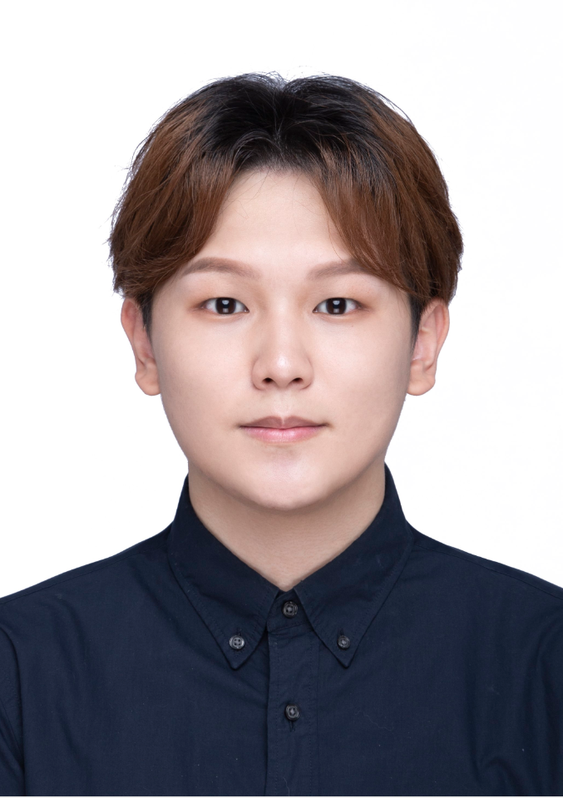
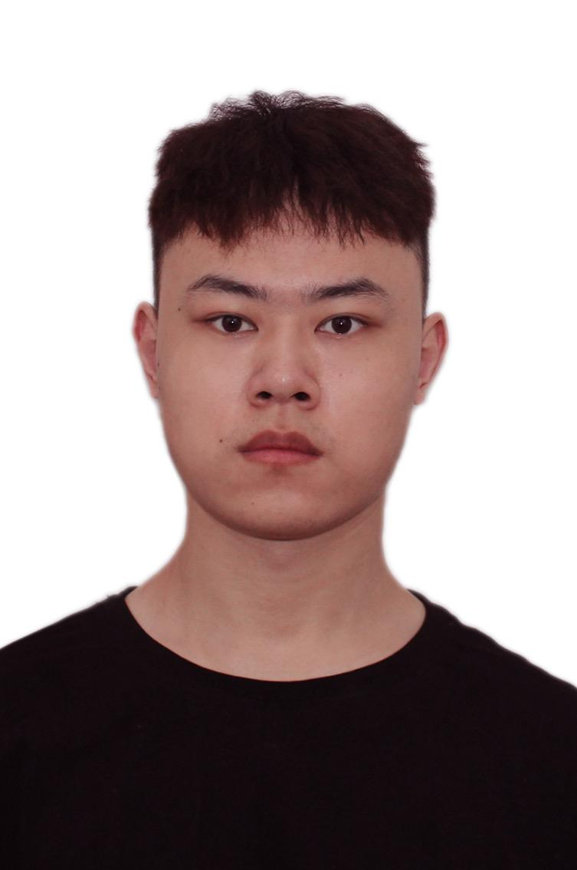


Team Breakdown
Jingbo Wang
Team rep
CS
2024
Zihan Li
Teammember
CS
2024
Jialong Ke
Teammember
CS
2024
Yuchen Cao
Teammember
CS
2024

Slide 3
Project Description
Our analysis and visualizations focus on improving how the City operates. This project will help the city understand trends that can be addressed at a strategic level.
Our project will focus on how remodeling and conversions impact rental units around the City of Boston, specifically how the movement of higher income individuals into the city might be REDUCING the number of housing units available because buyers are converting homes with multiple units into larger units, reducing the overall number of units available. This project looks at the role remodeling and zoning conversions have played in the housing markets in Boston.

Slide 4
Project Overview & Client MEETING
Build a working pandas codebase for analyse
Gather API data from Approved Building Permits and Property Assessment
Getting the first step of data cleaning
Try two diff ways to fetch data, and choose one as the main solution.
Using SQL API to fetch from website
Create a Python script named sqlDataFetch.py to get the database id, and fetch the data by the SQL query.
Create a Python notebook to let teammates know how to use "sqlDataFetch", and give some examples.
Solved everyone's problem with reading dataId. txt on different OS.
Initially address the goal of data analysis by needing to go over mean, median, and average.

Slide 5
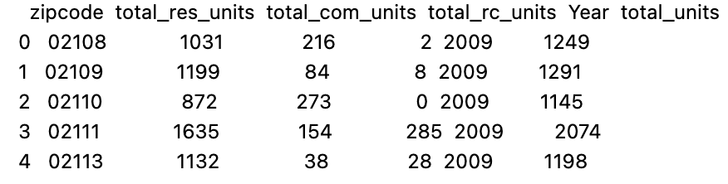
Preliminary analysis report
What communities are building more housing units?
Which ones are losing housing units?
Use propertyAssessmentDataFetch.ipynb to fetch data for 2009 - 2024(except 2014)
zip code
total_res_units,
total_com_units,
total_rc_units
Year
total_units
ZIPCODE vs ZIP_CODE vs zipcode
RES_UNITS, COM_UNITS, RC_UNITS
vs
S_UNIT_RES, S_UNIT_COM, and S_UNIT_RC

Slide 6
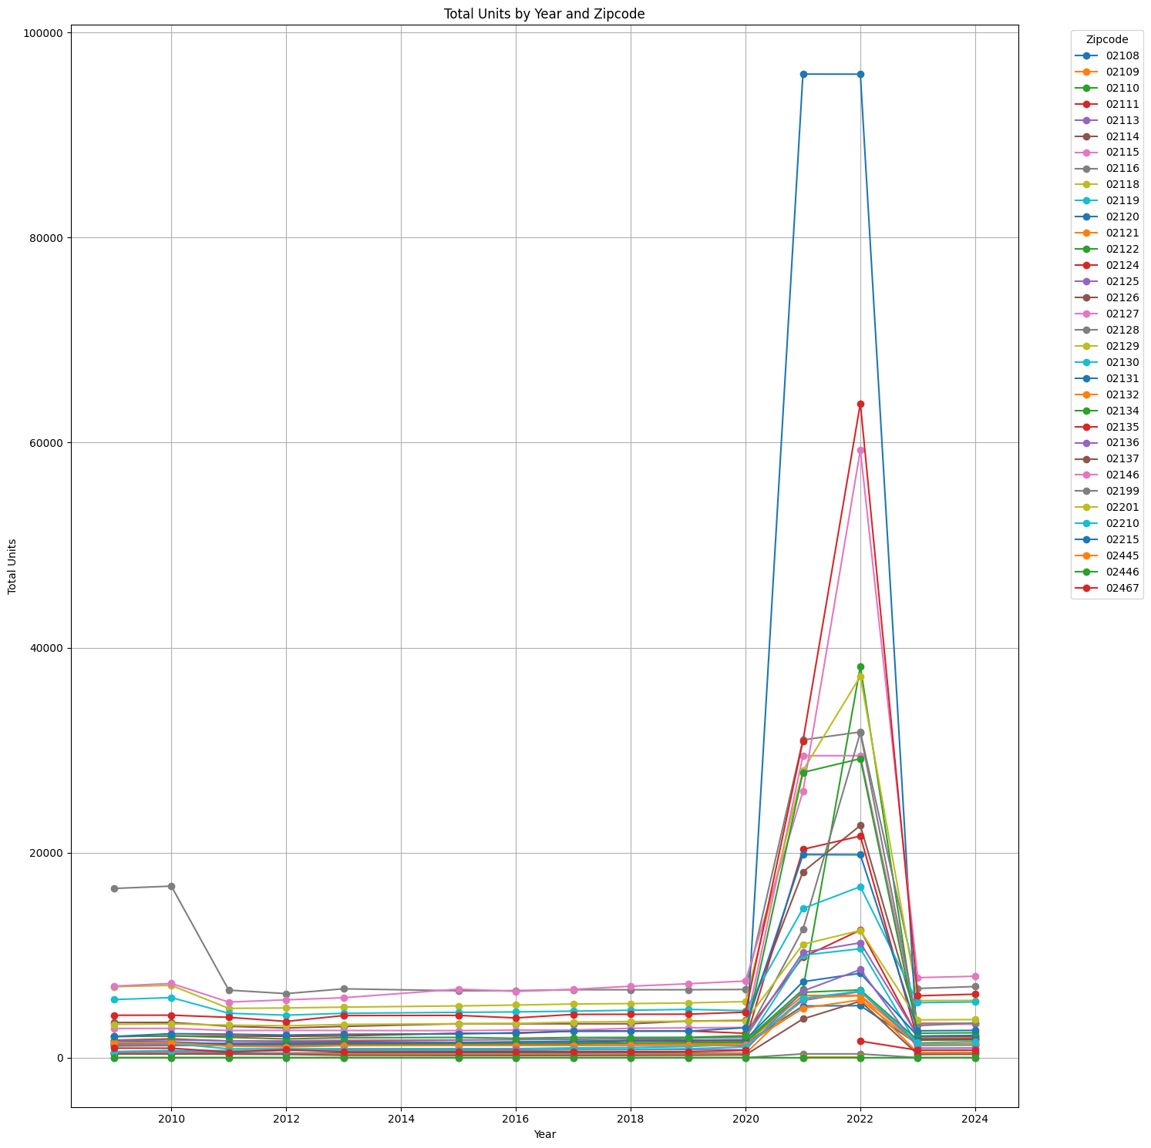
Preliminary analysis report

Slide 7
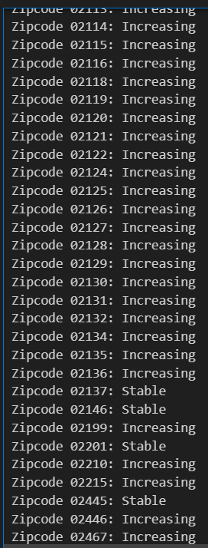
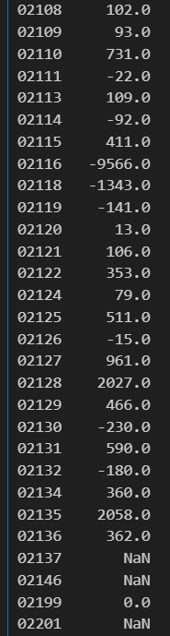
Preliminary analysis report

Slide 8
Tasks For next 2 weeks
Figure out the key component in Comprehensive analysis
Figure out that whether we need more data
Key findings from the base analysis
Proposal of possible extension analysis

Slide 9
Project Overall timeline
Project Kick off
Begin weekly scrum reports
Mid-Semester Report
Comprehensive analysis of project
February 28th
May 1st
Now - January 29th
April 8th
Early Insights Report
Preliminary analysis
Final Report
final report with visualizations, 3-4 key questions answered, and discussion of project findings.

Slide 10
Process OF working together
Meet for weekly client meetings
Discuss progress during weekly lab sessions
Team meet weekly every Friday to go over progress
Keeping track of and engaging with Trello board & Slack
Communicating with PM as needed

Slide 11
Tools and Documentation
Github: https://github.com/BU-Spark/ds-boston-remodeling/tree/team-b
Pandas Cheat Sheet: https://pandas.pydata.org/Pandas_Cheat_Sheet.pdf
Datasets: Property Assessment - Dataset - Analyze Boston Approved Building Permits - Dataset - Analyze Boston
Meeting Notes: Weekly Team Meeting Notes
Project Description Doc: City of Boston: Remodeling and Unit Loss

Slide 12
Project Deliverables

Slide 13
Future steps

Slide 14
DEMO

Slide 15
Blockers

Slide 16
Takeaways
Notes:
Lavette: Will profile save if previously entered? Yes!
Linda: Options to access D7 App is great!!
Lucky Henry: How will it verify the address? Ask Dev team
How will it prove lives in district or not? Could match to voter file but only gets voters not constituents
Lavette: How will we remove people who harass the Councilor? Prevent white supremacists
Lucky Henry: will it keep out people who don’t live in D7? Could use Utility bill, License, Lease, Deed
Linda: What is the level of privacy? Need to make sure the data are secure so that residents/voters in D7 are not subject to harassment and/or negative activity. Lavette: How often will there will be a sweep of the data to make sure its → Tania: daily
Lavette: is it possible to give the Councilor’s office a notification when there is a negative sentiment text? Yes, but this would be future development.
Lavette: Are there stated norms stated on the App? NO, need to add
Pricilla: Add field for youth development
Lucky Henry: community building, mental health
Lavette: Antiracist ordinances
Louis: can we post a picture with a comment?
Can the Councilor post a picture in their post? THIS AN IMPORTANT!!
What resources could be posted under
Lavette: keep boxes highest level as possible and go to sub-topics Councilor: can you search easily for sub-topics that are missing within broader topic and can you post same request for sub-topics → can we add “what resources are you looking for?”
Question
Councilor: goal to create own software for constituent services → the
Councilor: need another section with button for constituent services →
Lavette: How will it be different from the 311 app? User friendly…
Linda: public transportation-refer to mbta for updates under resources for transportation
Request: add button for constituent services at top of resource page and replace “submit request or report” below
City Council not given resources to manage constituent relations
311 TOOL:
311 automate scraping of D7 forms
Consider using a two-way post
Policy request: make 311 APIs
Questions:
Is there an address list of residents for D7?
Confirm:
that Councilor has to approve posts
can the Councilor remove people who are approved/ logins
City:
make sure they will always know that there are multiple events scheduled on same time for D6

Slide 17
Overcome Blockers

Slide 18

Thank you!

